Slide 1
Evaluating Food Restaurant Feasibility in London, United Kingdom using k-Means Clustering
Joanna Cez Dea Cruz

Slide 2
Content
Background
Problem and Interest
Data Sources
Method
Results
Conclusion

Slide 3
Background
Food restaurants has been a booming business all over the world – from fast food chains, formal dine-in setup, and on-the-go restaurants. Many international food corporation from US and other countries are investing in London, United Kingdom and expands their network there. There are also small corporations that are willing to risk in expanding their business in Europe. In this instant, it is important to understand the market before pushing through the business expansion

Slide 4
Problem and Interests
It is essential to determine which neighborhoods are the busy streets and can target the correct audience of their food restaurant. Can a business really bloom in a neighborhood where there are restaurants everywhere or should it build its own first restaurant with less competition. Moreover, we would also like to forecast on how long can a business survive in the neighborhood.

Slide 5
Data Sources
There will be four sources of data:
1. List of Neighbourhood(Areas) in London - https://en.wikipedia.org/wiki/List_of_areas_of_London
This contains Location which will be the neighborhood, area which is the borough.
2. Post codes and Location data - https://www.doogal.co.uk/AdministrativeAreas.php
This contains the borough list with latitude and longitude values.
3. Venues in the neighbourhood - Foursquare API
To be extracted from Foursquare API
4. London Borough profiles - https://data.london.gov.uk/dataset/london-borough-profiles#:~:text=The%20London%20Borough%20Profiles%20help,borough%2C%20alongside%20relevant%20comparator%20areas.

Slide 6
Method
1. Mapping Neighborhood and location data from the sources.
2. Identifying best K value for K Means Clustering using Elbow method.
3. Run Kmeans Clustering using neighborhood location data in London, United Kingdom
4. Identifying Cluster of interest matching demographic variables.
5. Computing the average business survival rate and create a new dependent variable where it is equal to 1 when survival rate is above average, and 0 otherwise.
6. Run a logistic regression to be able to identify the accuracy of using demographic variables as indicator whether to build a new food restaurant in an area.

Slide 7
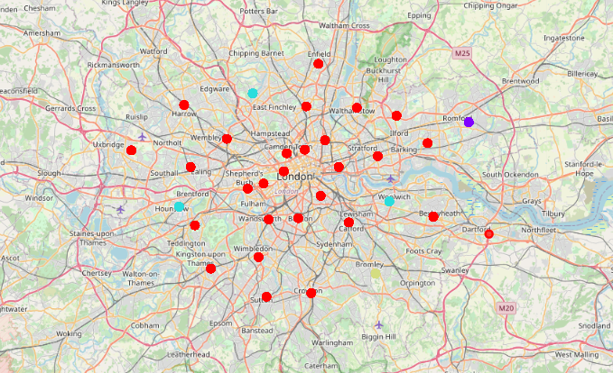
Results
Four Clusters of Neighborhood in London, United Kingdom

Slide 8
Results
Cluster | Description
1 – Pub, Stores, and Restaurants | Most common venues are Pub, stores, and restaurants. It is usually characterized as one of the busiest streets in London. This can be a good prospective when building a food restaurant.
2 – Recreation | Its top three most common venues are: Park, Yoga Studio, and Food Court.

Slide 9
Results
Cluster | Description
3 – Stores and Bus Stops | The most common venues are: Bus Stops and Stores. Although this is a good prospective also in which case there is less competitor, we will not be delving into this because of the few numbers of clusters involved.
4 – Fitness and Recreation | Its most common venues are Soccer Stadium, Gym centers, and Park. This is a more of recreational-centric neighborhood and might not be less target market in the area.

Slide 10
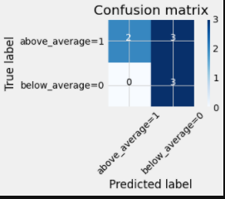
Results
This is the model capability with 100% predictability with below average survival rate neighborhoods. However, above average can only read up to 40% predictability.

Slide 11
Conclusion
Use elbow method in identifying K Means Clustering.
It is best to build a new food restaurant in Cluster 1 with Pub, Stores, and Bus Stops nearby as it is a good indicator of good business booming around the area.
Most of the time with below average of two-year business survival rate in London, United Kingdom.
It is suggested to be able to get richer data for the demographic variables and do a feature selection method to further identify the best model.
It is also suggested to create a different metric as threshold decision other than business survival rate.

